Slide 1
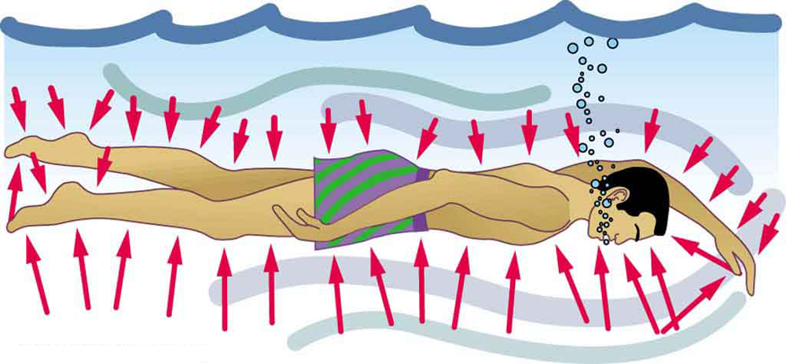
FLUIDS
NJ-OER TOPIC-11/12

Slide 2
Learning Outcomes
Define heat as transfer of energy. Calculate equilibrium temperature after heat transfer between two objects without phase change State energy conservation after heat transfer between many objects with or without phase change Calculate thermal conductivity. Calculate total heat transfer between a cold reservoir and hot reservoir Discuss the method of heat transfer by convection. Calculate the radiation power of different materials. Establish the relationship between the area, temperature, power, emissivity for objects that are going through a process

Slide 3
Concepts
ρ = Density
V = Volume
v = Velocity
A = Area
P = Pressure
Po= Zero level pressure
Po= 1 atm=1.01×10⁵ Pa for open containers under normal conditions
Po=0 for vacuum
h= Depth of the liquid column , measured downward
I = Rate of flow
FB = Buoyant force
Wdisplaced =Weight of the displaced fluid
Vs = volume of submerged part of the object
Vo= volume of an object
y= y coordinate of a point measured upward

Slide 4
Units
SI UNITS Density is in “kg/m³” Pressure is in Pascal “Pa” Height and y is in meters “m” Rate of flow is in “m³/s” NON-SI UNIT Pressure in atm Pressure in Hgmm Volume 1L= 10⁻³m³

Slide 5
Formulas and Constants
ρ=m/V Specific Gravity=Ratio of density of substance to water density 𝑃=𝐹/𝐴 Pgauge = Pabsolute−Patmospheric Pascal’s principle Pa=Pb at the same level of the liquid Archimedes’ Principle FB= Wdisplaced = ρ(liquid) V(object in the liquid) g when floating ρo/ρl=V(in)/Vo ρo/ρl=h(in)/ho Apparent Weight = mg – FB Apparent weight can be tension or normal force P=Po+ρgh For static fluids P=Po + ρ1 g h1 + ρ2 g h2 + ….. multiple layers P₁+ ½ ρ v₁² + ρgy₁ = P2+ ½ ρ v2² + ρgy₁ Bernoulli’s equation A1 v1 = A2 v2 continuity

Slide 6
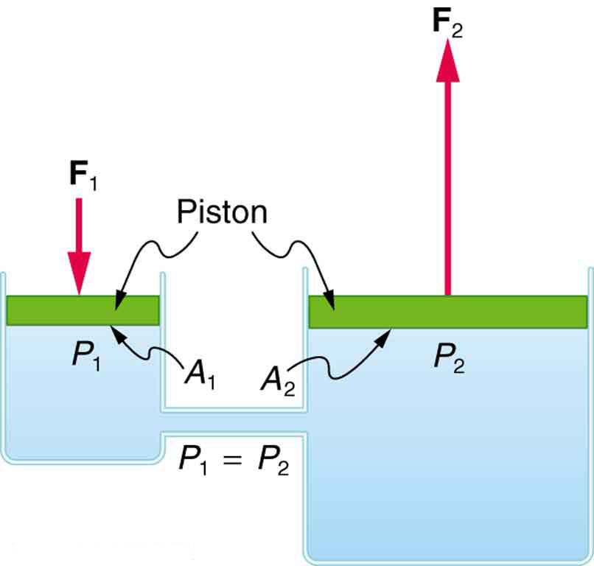
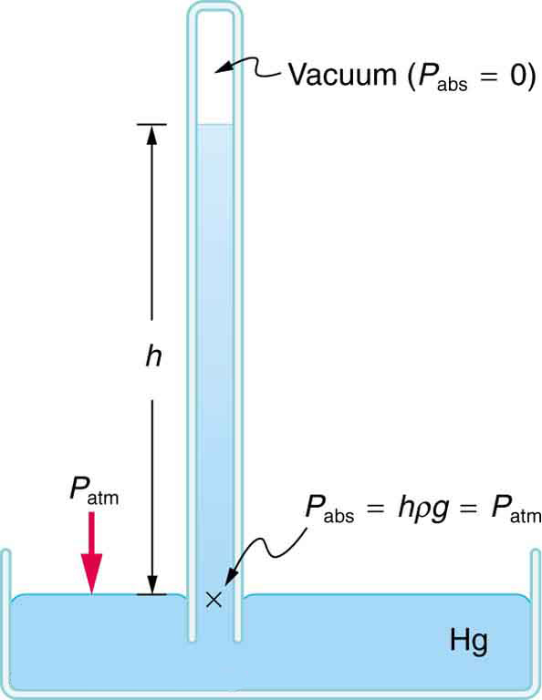
PASCAL PRINCIPLE Depth Variance of Pressure in Static Fluids
Hydraulic Press Barometer
Manometers

Slide 7
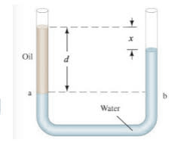
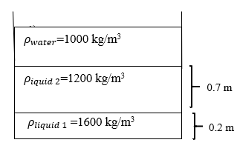
CLASSWORK FOR PASCAL PRINCIPLE
Q1) A 10,000 N car is on a circular hydraulic press plate with radius 2 meters. A smaller plater with radius 0.4 meters is used for lifting the car. What is the force required to hold the car in equilibrium?
Q2)A U-tube manometer is filled with water. Oil with density 950 kg/m3 is poured on one side to the height of 0.10 m. What is the level difference between the two side of u-tube? (Pa=Pb)
Q3) 3 layers of liquid is poured on top of each other. What should be the height of water at the top so that the pressure at the bottom of the container is 120 kPa.
Q4) What is the level of the liquid in a Barometer under normal Atmospheric conditions if
A) Liquid water is exposed to air and the other side is a vacuum
B) Liquid mercury is exposed to air and the other side is a vacuum
C) Liquid mercury is exposed to air and the other side is closed, containing gas with pressure 90,000 Pascal

Slide 8
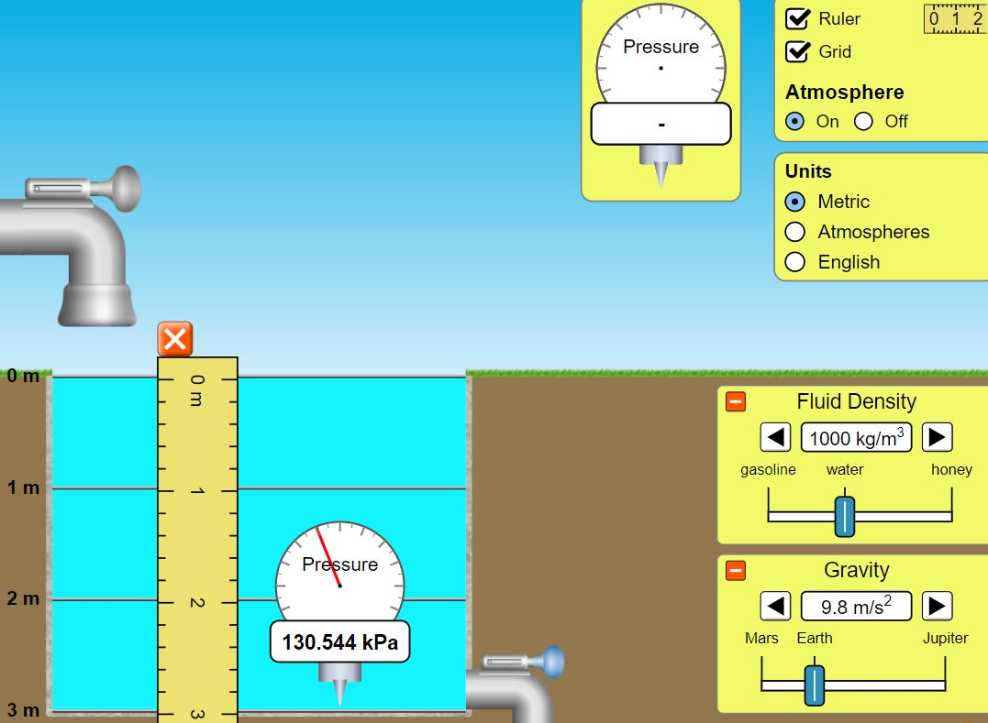
ACTIVITY FOR DEPTH VARIANCE OF PRESSURE
Open the under pressure app at PhET
https://phet.colorado.edu/en/simulations/under-pressure
Choose the first option. Click on ruler and grid.
Start with water as your liquid. Set gravity to 9.8 m/s²
Fill the tank by opening the faucet
Drag the pressure gauge, record its value at various depths
Calculate the pressure at various depths and compare
Fill the table below. Repeat the activity using different liquids and different gravity.
DATA: Density: Gravity: Po:
Depth (meters) | Pressure measured (units) | Pressure Calculated (units)
1
2
3

Slide 9
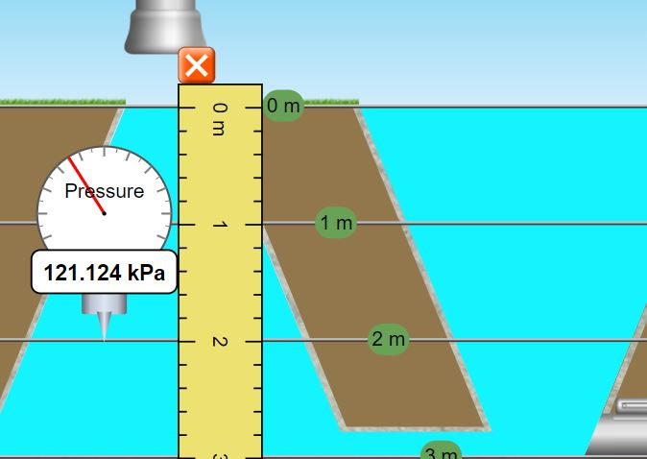
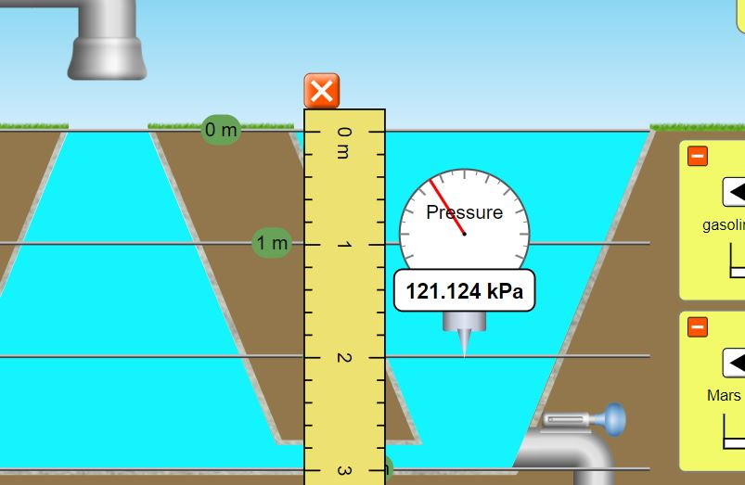
ACTIVITY FOR PASCAL PRINCIPLE
Open the under pressure app at PhET
https://phet.colorado.edu/en/simulations/under-pressure
Choose the second option. Click on ruler and grid.
Fill the tank by opening the faucet
Drag the pressure gauge, record its value at various depths
For each depth record pressure on the left and on the right
Fill the table below. Repeat the activity using different liquids and different gravity.
DATA: Density: Gravity: Po:
Depth (meters) | Pressure Left (units) | Pressure Right (units)
1
2
3

Slide 10
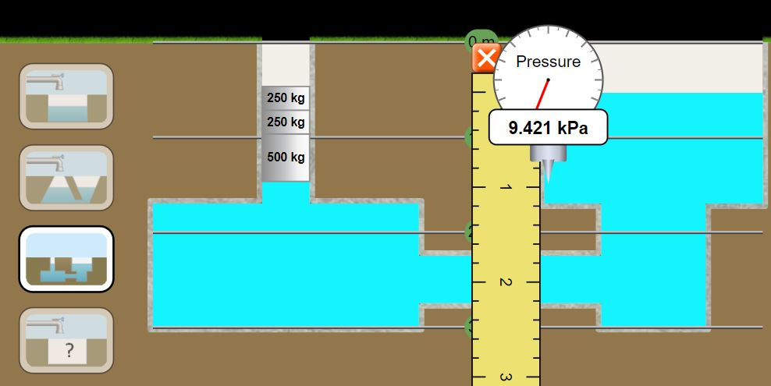
ADVANCED ACTIVITY FOR PASCAL PRINCIPLE
1000 kg mass is placed on the left side of a u-shaped tank as shown in the graph. As a result, left side is pushed down by 0.96 meters relative to the right side. Using the Pascal principle and depth variance of pressure calculate the surface area of the 1000 kg mass.
Open the under pressure app at PhET
https://phet.colorado.edu/en/simulations/under-pressure
Choose the third option.
Place all the masses on the left side
Turn off the atmospheric pressure.
Find the pressure of right from the depth
Find the force on the left using W=mg
Find the expression for the Pressure on the left using P=F/A
Set P(left)=P(right) solve for the unknown area.
Change liquid density, gravity and mass and repeat the activity. Level difference between the left and the right side can be measured using the ruler tool or calculated using the pressure on the right.

Slide 11
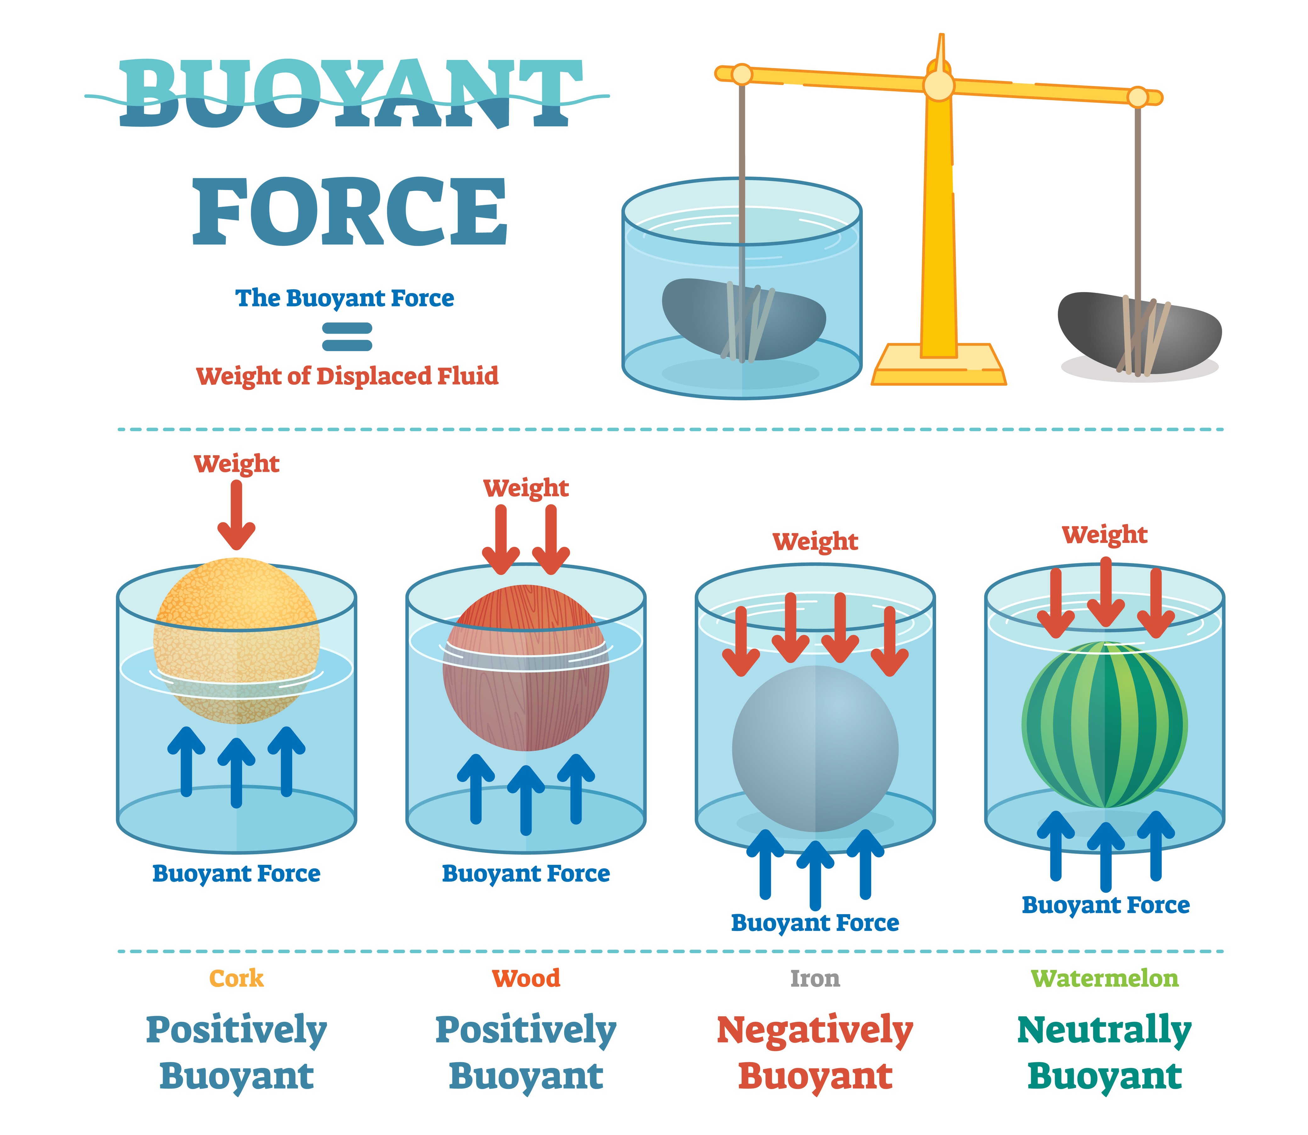
CLASSWORK FOR ARCHIMEDES PRINCIPLE
Floating Objects
Sinking Objects
Q1) 0.12 kg cork with 0.05 m³ Volume is floating inside water. What is the volume inside the water?
Q2) A piece of wood is in sea water. What is the density of the log if 60% of the log is inside the water?
(salt water density is 1030 kg/m³)
Q3) Watermelon is floating inside a liquid with 100% of its volume is inside. What is the condition for this float?
Q4) 7 kg Iron is placed inside water. What is the normal force acted on it? (Density of Iron is 7900 kg/m³)
A) Find its weight
B) Find its volume
C) Find FB and Apparent Weight
Q5) Aluminum with 0.2 m³ volume is placed inside the water on a triple beam scale. What is the tension on the wire that holds the aluminum. (Density of Aluminum is 2700 kg/m³)
A) Find its mass and its weight
B) Find FB and Apparent weight
Floating
ρo/ρl=V(in)/Vo
ρo/ρl=h(in)/ho
Sinking
Apparent Weight = mg – FB
FB= Wdisplaced
FB=ρ(liquid) V(object) g

Slide 12
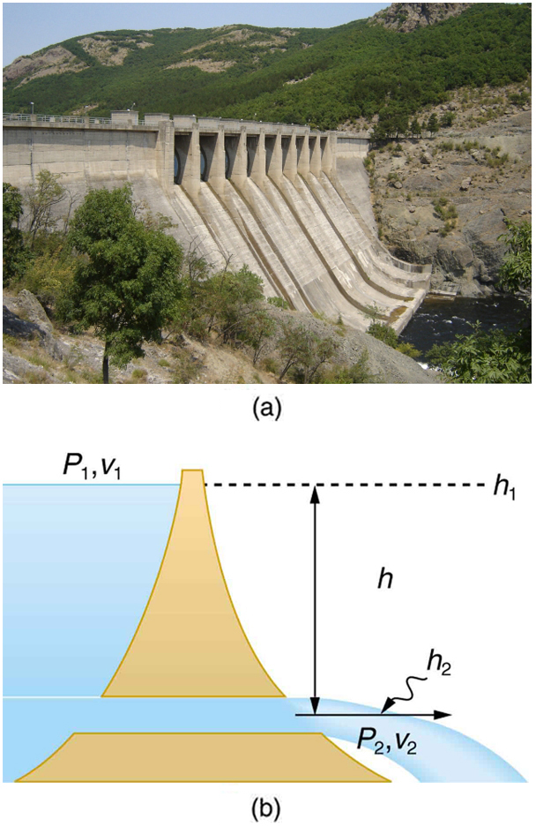
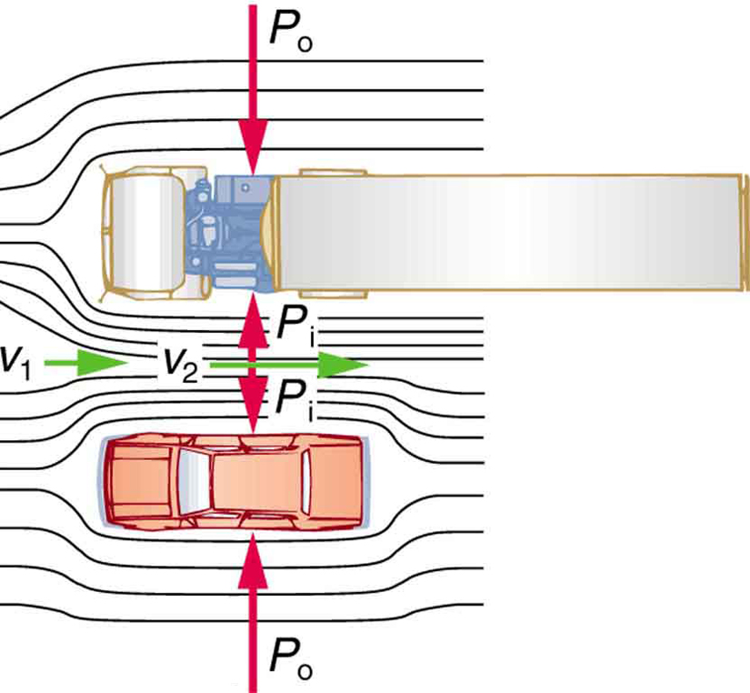
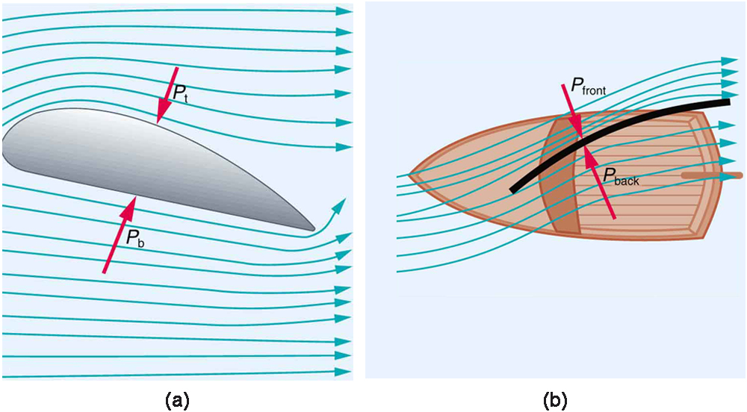
KEY STRATEGIES FOR BERNOUILLI'S EQUATION
P1+ ½ ρ v1² + ρgy1 = P2+ ½ ρ v2² + ρgy1 Bernoulli’s equation A1 v1 = A2 v2 continuity equation
Find two reference points with either different speeds, different heights or pressure
Label them with the index 1 and index 2
From the word problem and/or graph identify P1, v1, y1, P2,v2,y2
Identify your unknown
Write the Bernouilli's equation and solve for the unknown using the numbers given in the problem
SPECIAL CASES
If the pressure difference is asked, solve for either P2-P1 of P1-P2
If pipe is vertical y1=y2, cross them out
If both sides are open to air P1=P2, cross them out
If the pipe size doesn't change, v1=v2 cross them out

Slide 13
CLASSWORK FOR BERNOUILLI'S EQUATION
Q1) A water tank is 5 meters tall. At the base of the tank there is hole. What is the velocity of the water coming from the hole? Consider that the water speed at the top is negligible.
Q2) Water is flowing from a wide vertical pipe with v=3 m/s. At one point the pipe narrows due to build up and as a result water’s velocity becomes v= 7 m/s. What is the pressure difference between the narrow point and wider point?
Q3) Water is flowing from a Z-shaped tube with constant cross-sectional area. The height difference between the top and the bottom is 0.50 meters and water pressure at the top is 6000 Pa. What is the water pressure at the bottom?
Q4) Water is flowing from a diagonal tube. At the ground level of the tube the speed of 4 m/s and the pressure is 70000Pa. What is the pressure in the tube 5 meters above the ground, if the water flows with speed of 6 m/s due to narrowing? Find the ratio of the areas at the bottom to the top

Slide 14
REFERENCES
Slide 1-6-12 Open Stax College Physics online textbook
Slide 7: Gen-Ed-Phys-I Workbook by M.Tabanli and J. Meenu and Open Stax College Physics online textbook
Slides 8-9-10 Screenshot from PhET Interactive Simulations University of Colorado Boulder
Slide 11: Adobe id= 196756658 Buoyant force, illustrative educational physics diagram.By VectorMine

